Slide 1

ASP.NET WEB API

Slide 2

WEB API
(Application programming interface)
i. API is some kind of interface which has a set of functions that allow programmers to access specific features or data of an application.
ii. It is an API over the web which can be accessed using HTTP protocol.
1.Interface?
2.Http protocol?
3.Other protocols?
4.Why protocols?
5.Why we need api instead of a mvc application?
1.FTP(File Transfer Protocols)
2.UDP(User Datagram Protocol)
3.HTTP(Hyper Text transfer protocol)
4.HTTPS(Hyper Text Transfer Protocol Secure)
Ex: Twitter APIs, LinkedIn APIs, Facebook APIs

Slide 3
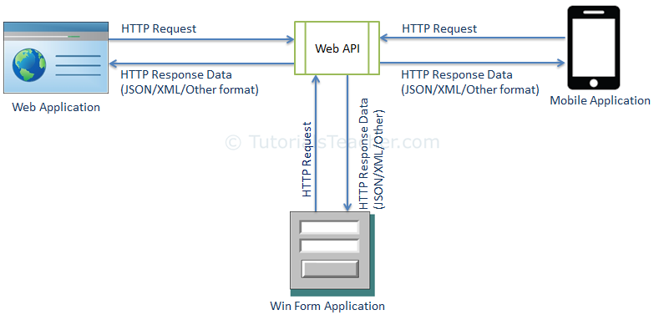
DB

Slide 4
Microsoft versions of services
1.Service with XML as a web Service ( .ASMX) in 2002
2.Microsoft added the broadly capable Windows Communication Foundation (WCF) a few years later.
3.The ASP.NET Web API (a powerful framework for building HTTP-only).
1.
2.
Web API 1.0 | .NET Framework 4.0
Web API 2 - Current | .NET Framework 4.5

Slide 5
WCF(Windows communication foundation)
It’s a framework for building service-oriented applications.
Supports HTTP, TCP, UDP and custom transport protocol.
It is based on SOAP and return data in XML form(WSDL).

Slide 6
ASP.NET WEB API
\\192.168.68.35\Team\Development\STEP 2017\Advanced (2nd Month)
ASP.NET Web API is a framework that makes it easy to build HTTP services that reach a broad range of clients, including browsers and mobile devices. ASP.NET Web API is an ideal platform for building RESTful applications on the .NET Framework.

Slide 7
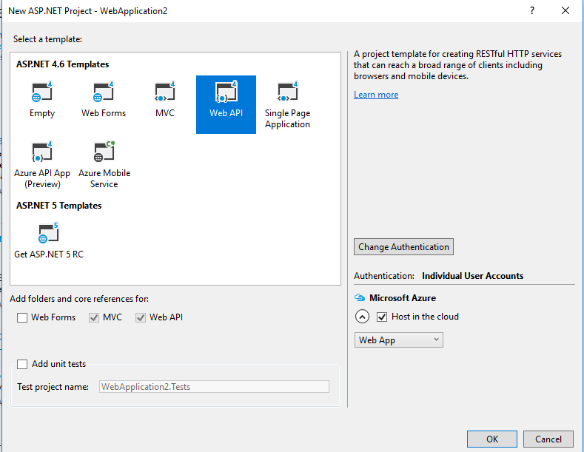
How to create your first WEB API project
New Project->WEB API->

